Slide 1
Curriculum Design
Dianna Xu

Slide 2
Websites
Main project website
http://www.cs.brynmawr.edu/visual
CS1 course material repository
http://www.cs.brynmawr.edu/gxk2013

Slide 3
Philosophy
Teach the core CS1 topics as we would in any average traditional Java-based CS1
Show applications of these principles with contemporary, diverse examples of computing in a modern context
Main differences are in the class examples and assignments

Slide 4
Philosophy
Introduce students to advanced areas not typically accessible in CS1
Physics-based simulations
Fractals and L-systems
Image processing
Emergent systems
Cellular automata
Data visualization

Slide 5
Our Experiences
16 CS1 and 2 CS2 courses have been offered over the course of 2 years
Overwhelmingly positive student interest and feedback
10% of Bryn Mawr’s undergraduate student population now takes our CS1
Strong indication of attracting women and non-STEM or undecided majors

Slide 6
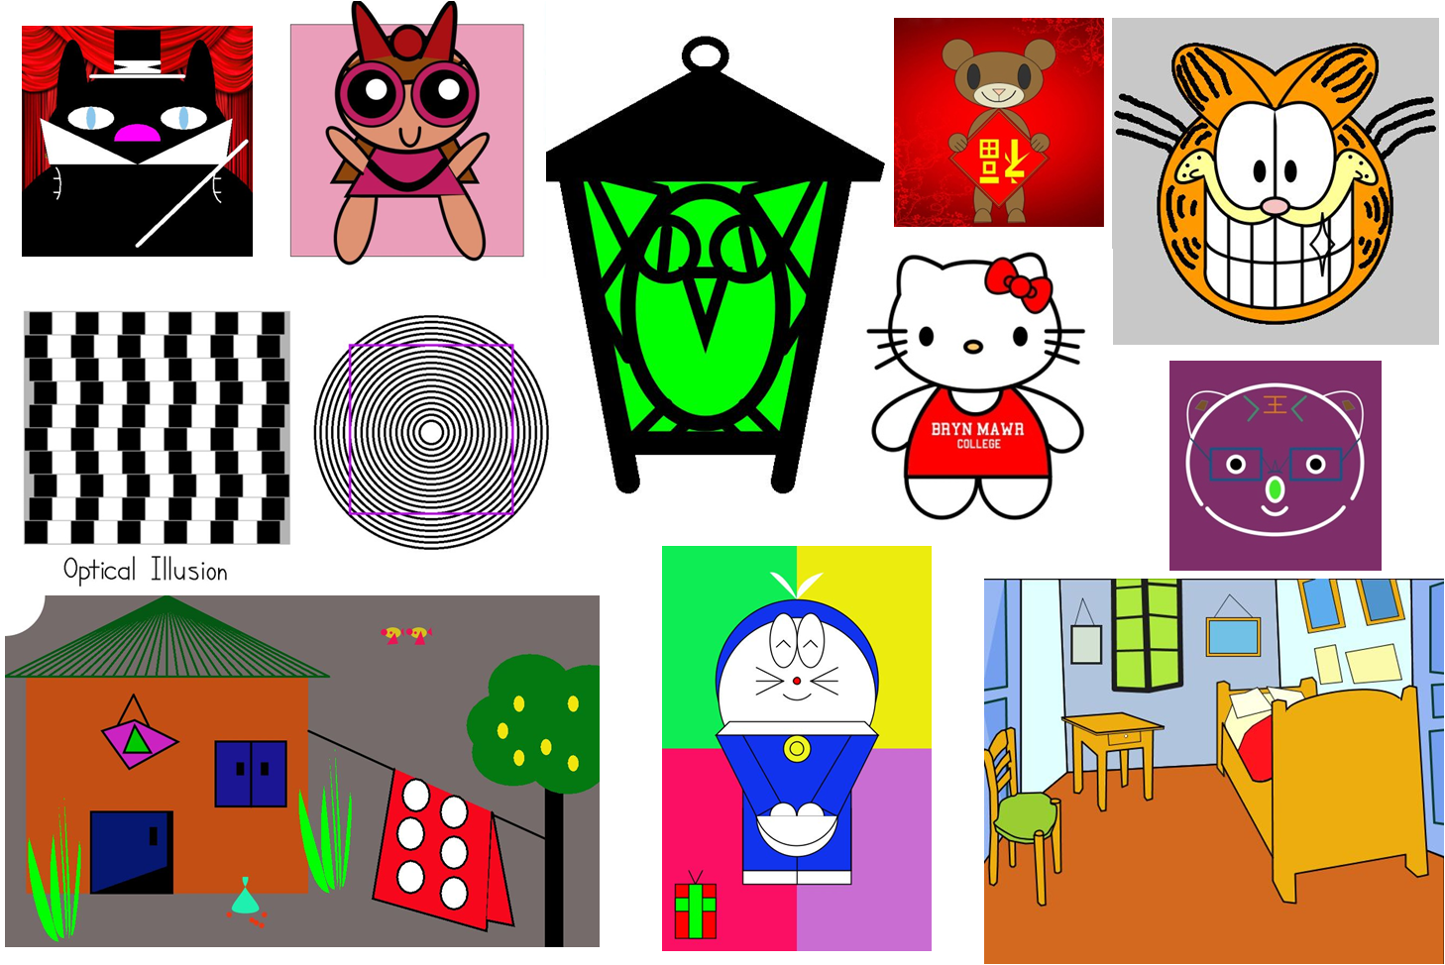
Introduction
Creative coding principles
Built-in primitive, color/stroke functions

Slide 7
Variables, Types and Expressions
Reinforced through assignments that require drawing in scale proportional to some variable

Slide 8
Control Structures
Conditionals are taught to students in the context of creating simple physics simulations: animations of ball dropping, bouncing in window, etc

Slide 9
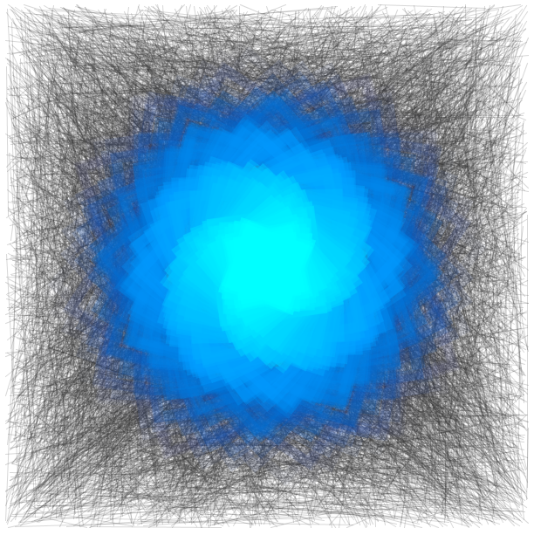


Iterations
Natural concept in drawing

Slide 10
Functions
Used to parameterize shape drawing (location, size, color, etc.)
Combined with loops and randomization

Slide 11
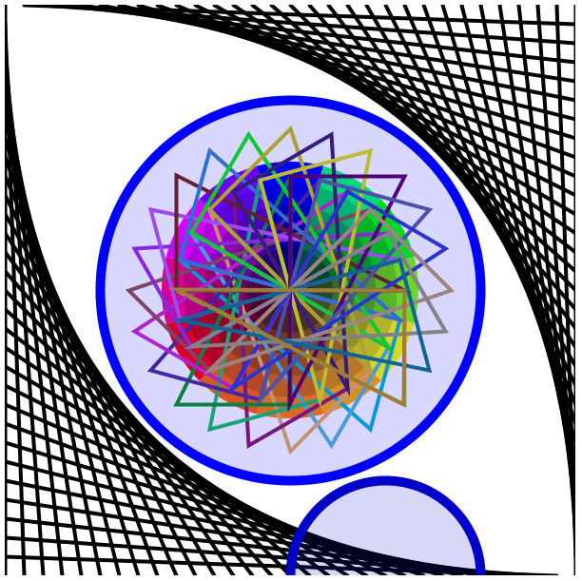

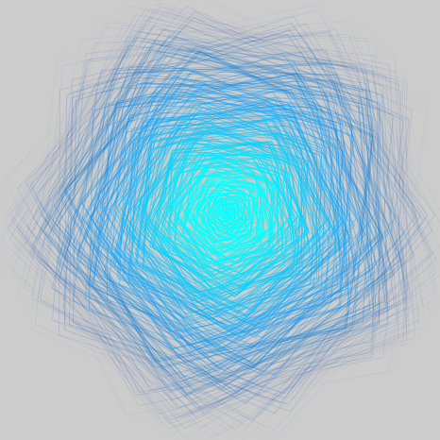
Mathematical Concepts
Basic trigonometry and rotational geometry
Polar coordinates

Slide 12
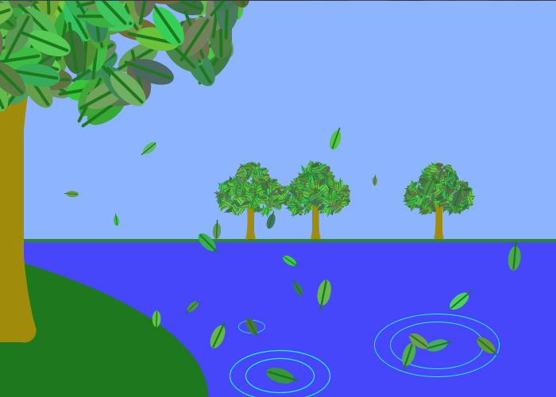
OOP
Design shapes as objects
data fields to store physical and drawing parameters
methods that implement rendering and animation

Slide 13
Arrays and arrayList

Slide 14
Inheritance

Slide 15
Recursion

Slide 16
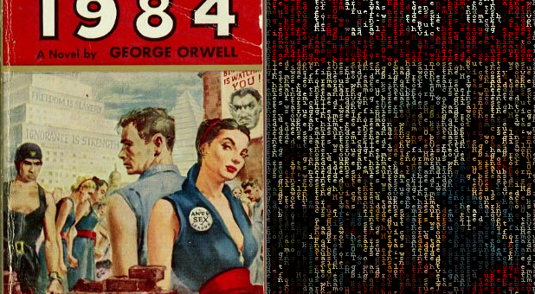
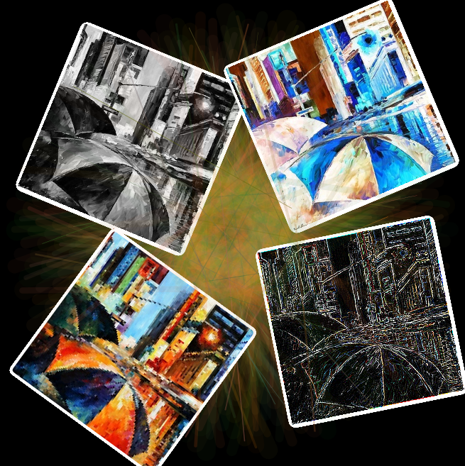
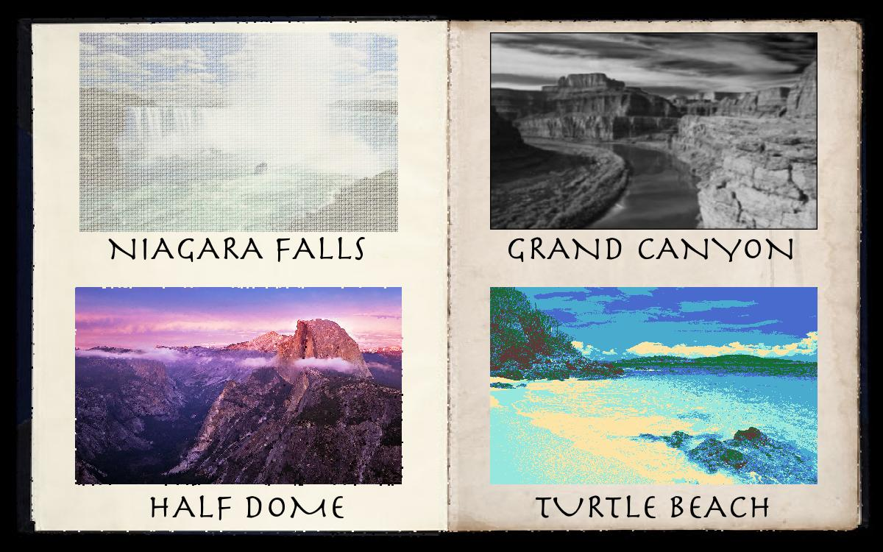

Image Processing

Slide 17
2D Arrays Creatively
Cellular Automata (Game of Life)
Emergent Systems
Tiling

Slide 18
Data Visualization

Slide 19
Data Visualization

Slide 20
Text Visualization

Slide 21
TreeMap

Slide 22
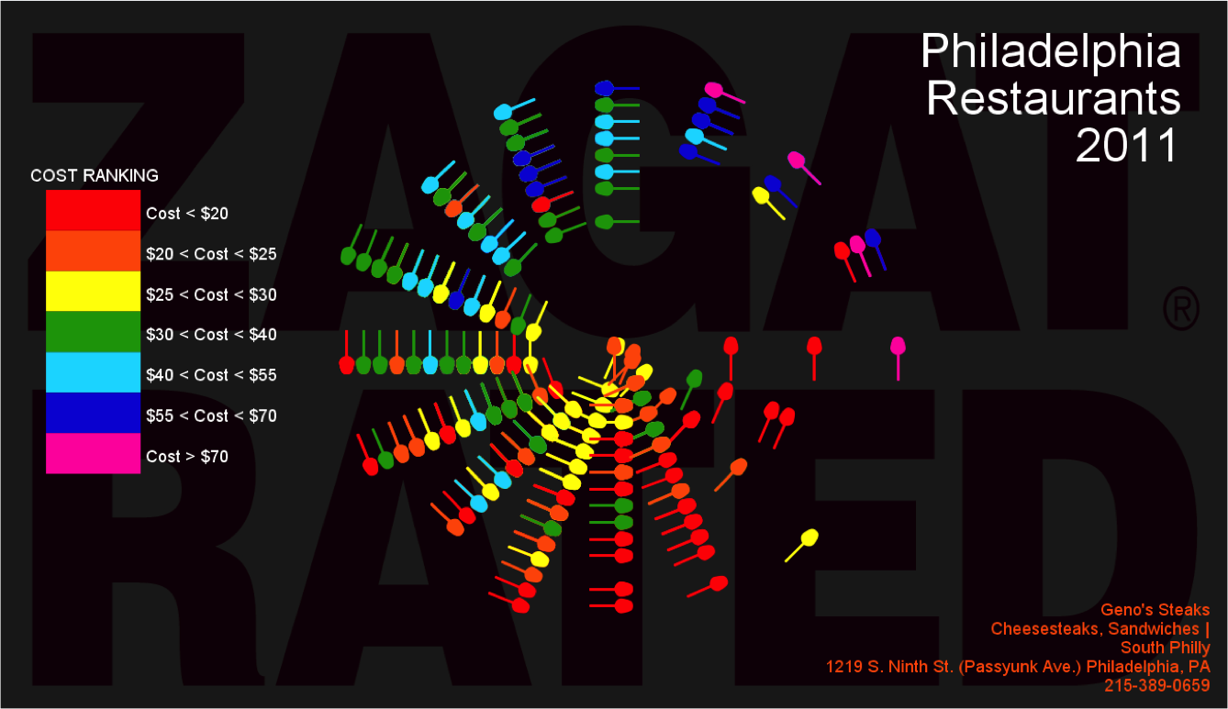


Student Projects

Slide 23
